Slide 1


EmPhAsIS Empowering Pharmacists in Asthma management through Interactive SMS
Baseline Procedures:
Recruiting and Screening Patients
emphasis.core.ubc.ca
Click for more information

Slide 2



Eligibility Criteria for Patients
+
3. Prescribed with inhaled corticosteroids
2. Diagnosed with asthma
4.Have a cell phone with text capabilities
1. 14 years or older

Slide 3
1. Recruit
+
Once you have identified a patient fulfilling the eligibility criteria, it’s time to ask them if they are interested in the study and begin recruiting!

Slide 4
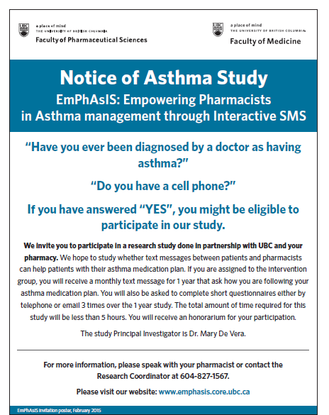
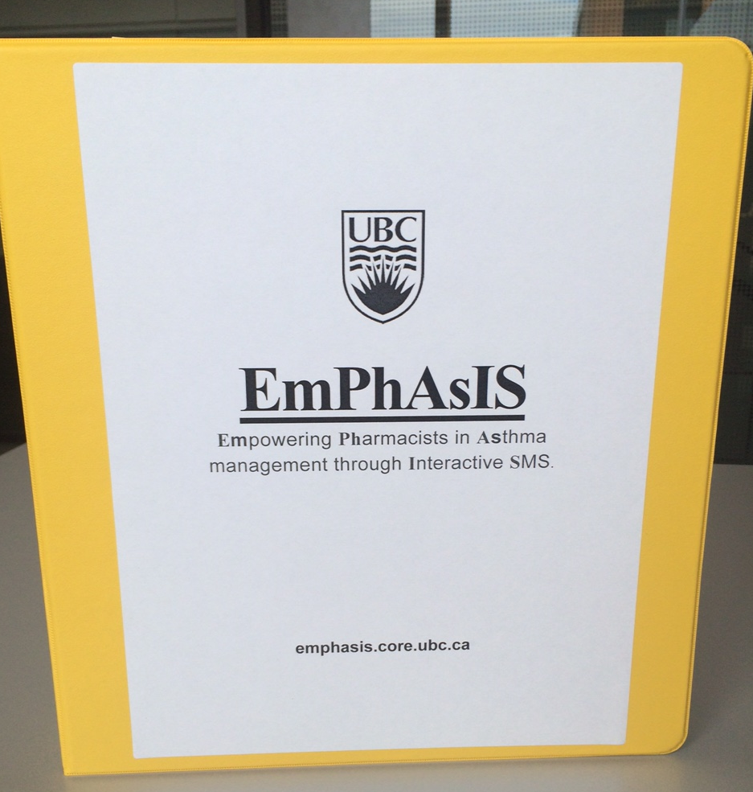
1. Recruit
+
In your binder
Study Ad (colour & black/white)
Tip
Post ad on:
Wall by counseling area
Counter

Slide 5
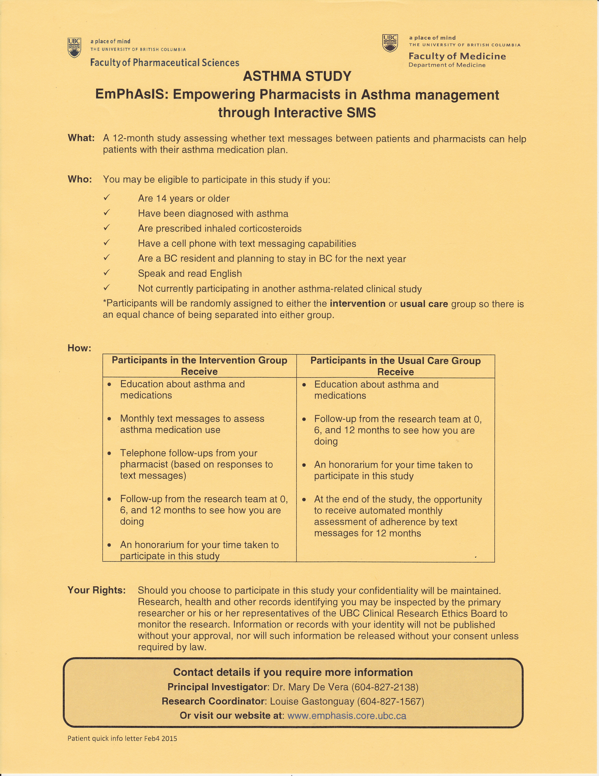
1. Recruit
+
In your binder
Patient Quick Info Letter
Tip
Use to explain EmPhAsIS study to patients
Hand out to asthma patients as bag stuffers

Slide 6
1. Recruit – The 6 Steps
+
Introduce yourself and Explain pharmacy participation
Describe purpose of EmPhAsIS study
Explain what EmPhAsIS study involves
Tell participants what they will receive
Explain voluntary nature of participation
Emphasize importance of participation

Slide 7
1. Recruit – The 6 Steps
+
Introduce yourself and Explain pharmacy participation
“Our pharmacy is part of a research study offered through UBC looking at asthma medication adherence”
Describe purpose of EmPhAsIS study
Explain what EmPhAsIS study involves
Tell participants what they will receive
Explain voluntary nature of participation
Emphasize importance of participation

Slide 8
1. Recruit – The 6 Steps
+
Introduce yourself and explain pharmacy participation
Describe purpose of EmPhAsIS study
“We will study whether monthly text messages from our pharmacy will help with using your asthma medications to improve control of your asthma”
Explain what EmPhAsIS study involves
Tell participants what they will receive
Explain voluntary nature of participation
Emphasize importance of participation

Slide 9
1. Recruit – The 6 Steps
+
Introduce yourself and explain pharmacy participation
Describe purpose of study
Explain what EmPhAsIS study involves
“You will be randomly assigned to a study group. If it is the intervention group, you will receive monthly text messages with a pharmacist following up if there are any concerns. If it is the usual care group, you will not receive the monthly text messages, but have the option to at the end of the study”
Tell participants what they will receive
Explain voluntary nature of participation
Emphasize importance of participation

Slide 10
1. Recruit – The 6 Steps
+
Introduce yourself and explain pharmacy participation
Describe purpose of EmPhAsIS study
Explain what study involves
Tell participants what they will receive
“Researchers at UBC will follow-up with you when you start the study, and then again in 6 months and 12 months. You will receive $25 at the end of the study”
Explain voluntary nature of participation
Emphasize importance of participation

Slide 11
1. Recruit – The 6 Steps
+
Introduce yourself and explain pharmacy participation
Describe purpose of EmPhAsIS study
Explain what EmPhAsIS study involves
Tell participants what they will receive
Explain voluntary nature of participation
“If you agree to participate, but change your mind later on, you are free to withdraw at any time”
Emphasize importance of participation

Slide 12
1. Recruit – The 6 Steps
+
Introduce yourself and explain pharmacy participation
Describe purpose of EmPhAsIS study
Explain what EmPhAsIS study involves
Tell participants what they will receive
Explain voluntary nature of participation
Emphasize importance of participation
“You will help identify new and exciting ways to help asthma patients and your assistance and participation would be greatly appreciated”

Slide 13
Tips for Successfully Recruiting Participants
Engage as many patients as possible, do not get discouraged
Approach patients you know might be interested from your prior interactions with them
Use study ads provided to increase visibility of the study around the pharmacy
Keep study introduction to patients short

Slide 14
2. Screen for Eligibility
+
If the patient agrees to participate in the study, complete the
Participant Screening Form

Slide 15
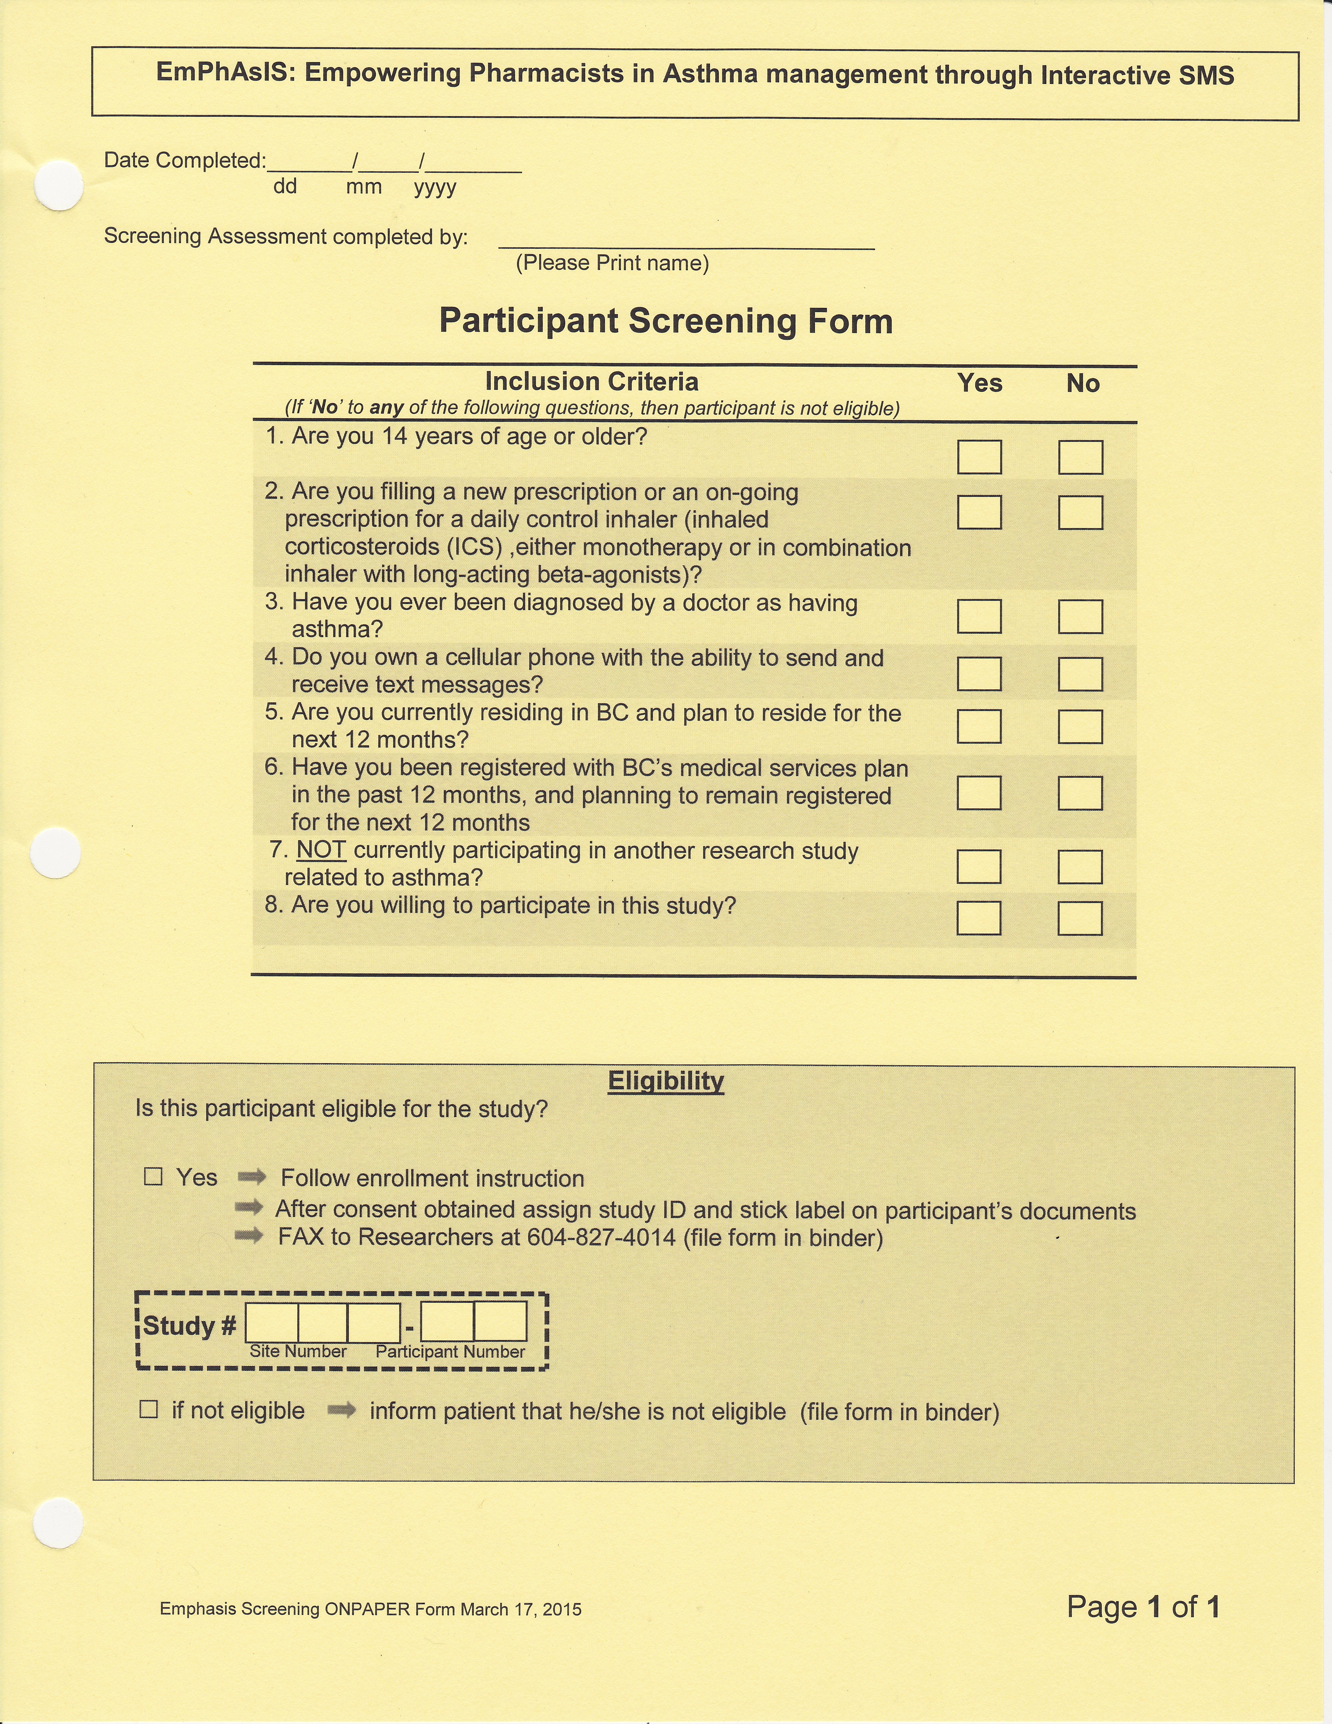

2. Screen for Eligibility
+
In your binder
Participant Screening Form
OR
Via website
Online Participant Screening Form

Slide 16
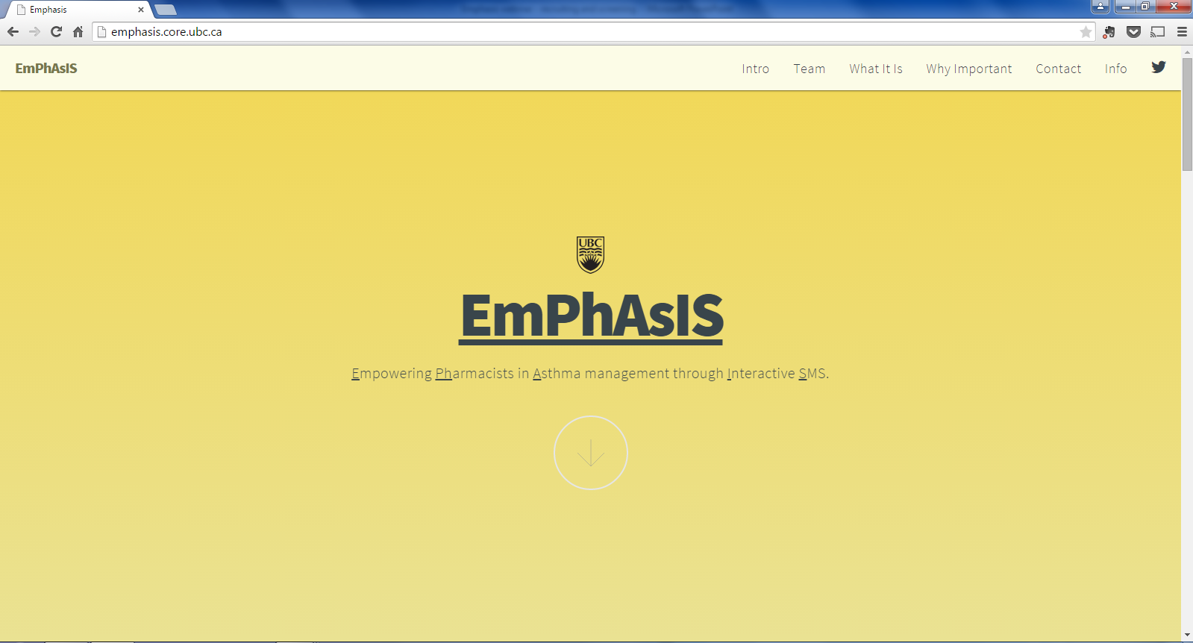
2. Screen for Eligibility
+
Access the online version of the Participant Screening Form through the EmPhAsIS Website: emphasis.core.ubc.ca
Click on Info

Slide 17
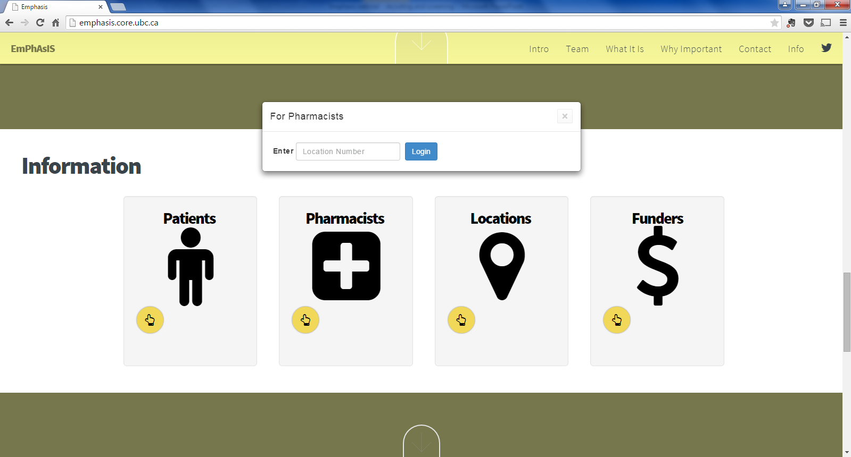
2. Screen for Eligibility
+
Enter your Username
(i.e. phar007)
Click on Pharmacists

Slide 18
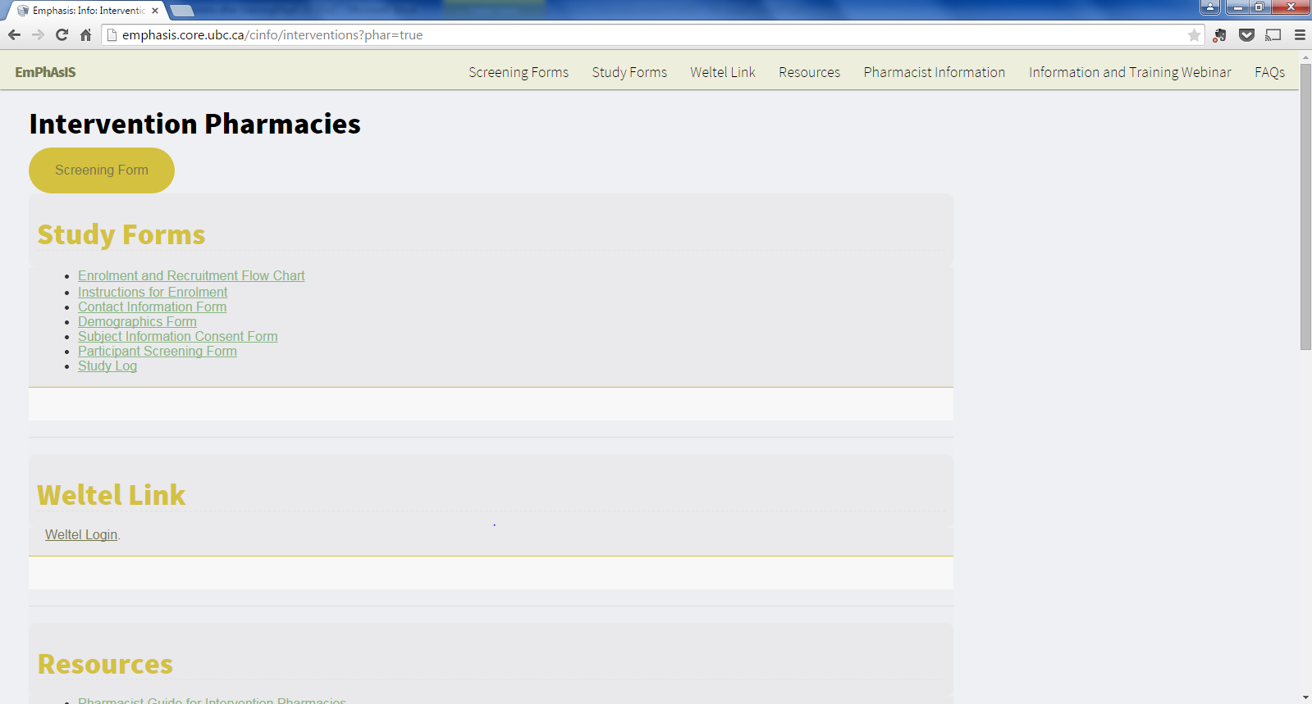
2. Screen for Eligibility
+
Click on Screening Form

Slide 19
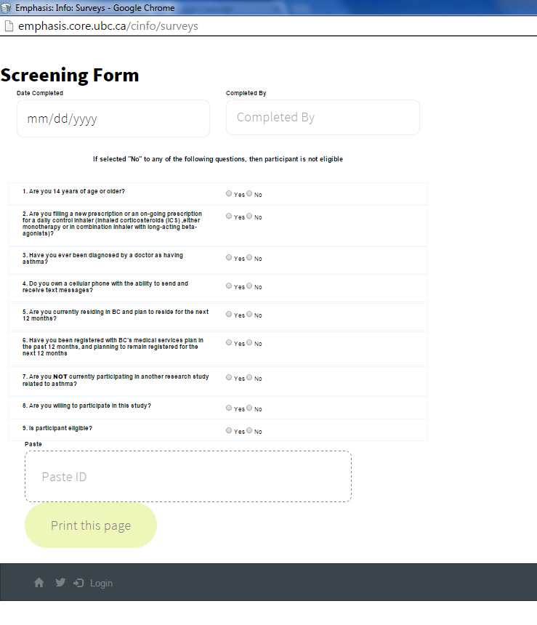
2. Screen for Eligibility
If using the online Screening Form, remember to print the form after completing

Slide 20
2. Screen for Eligibility
+
If NOT eligible, inform patient and file form in the back of binder
***No Patient Study ID needed***

Slide 21
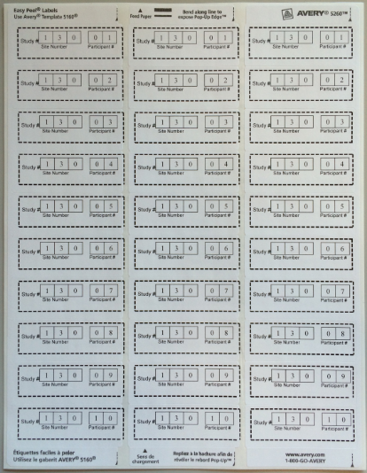
2. Screen for Eligibility
+
If eligible, stick the Patient Study ID sticker (provided in the back of the binder) onto the form
***Each participant should have their own unique Patient Study ID***

Slide 22
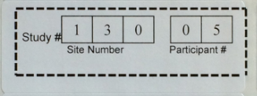
2. Screen for Eligibility
+
If eligible, stick the Patient Study ID sticker (provided in the back of the binder) onto the form
***Each participant should have their own unique Patient Study ID***

Slide 23
Patient Study ID
Each patient has their own unique Study ID
Use the same Study ID for the same patient on each of the different forms
Patient 1
Each row is a different Study ID
(Use the same row for each patient)
Patient 2
Patient 3

Slide 24
2. Screen for Eligibility
Once the screening form has been completed and patient is eligible for the EmPhAsIS study…
Stick patient Study ID onto the form
Fax to UBC 604-827-4014
If patient is ineligible, inform patient and file the form at the back of the binder
No patient Study ID needed
No need to fax to UBC

Slide 25
Congratulations!
You have now successfully recruited and screened a study participant!
For patients who are eligible to participate in the study,
please see next mini-webinar on:
“Consenting and Enrolling Patients”

Slide 26
EmPhAsIS Empowering Pharmacists in Asthma management through Interactive SMS
Questions?
Please do not hesitate to contact us
Dr. Mary De Vera at 604-827-2138 (mdevera@mail.ubc.ca)
Research Coordinator (Louise) at 604-827-1567 (louisega@mail.ubc.ca)
Fax: 604-827-4014
Mailing Address
2405 Wesbrook Mall, Vancouver BC, Canada V6T 1Z3

